Slide 1


Switched Nonlinear Systems: Stability Analysis via Average Dwell Time and Average Activation Time Switching
Shenyu Liu
School of Automation, Beijing Institute of Technology

Slide 2

Outline
Switched system overview
Deterministic stability
Stability/stabilization via ADT/AAT switching
General ISS/iISS switching signals for switched systems with nonlinear supply functions
Application study: data-driven approach for online stabilization of unknown switched linear systems
Stochastic stability
GAS a.s. via ADT/AAT conditions
Asymptotic moment stability via studying auxiliary linear time-delay system
Conclusion and future work

Slide 3
Related work
[A] Liu, S., Russo, A., Liberzon, D. and Cavallo A. (2021). On Integral Input-to-State Stability of Time Dependent Switched Systems with Dwell Time Switching. IEEE Transactions on Automatic Control vol. 67, issue 11, 5841–5855.
[B] Liu, S., Tanwani, A. and Liberzon, D. (2021). ISS and Integral-ISS of Switched Systems with Nonlinear Supply Functions. Mathematics of Control, Signals, and Systems, vol. 34, 297–327.
[C] Liu, S., Russo, A. (2022). Further characterizations of integral input-to-state stability for hybrid systems. Provisionally accepted by Automatica.
[D] Eising, J., Liu, S., Martinez, S. and Cortes, J. (2022). Using Data Informativity for Online Stabilization of Unknown Switched Linear Systems. In proceedings of the 61st IEEE Conference on Decision and Control, 8–13.
[E] Liu, S. (2022). Characterizations and Stability Criteria for the 2-Mode Markovian Switched Nonlinear Systems. Conditionally accepted by IEEE Transactions on Automatic Control.
[F] Liu, S. Wen, P. (2023). Non-conservative Stability Criteria for Semi-Markovian Impulsive Switched Systems. Submitted to SIAM Journal of Control and Optimization

Slide 4
Outline
Switched system overview
Deterministic stability
Stability/stabilization via ADT/AAT switching
General ISS/iISS switching signals for switched systems with nonlinear supply functions
Application study: data-driven approach for online stabilization of unknown switched linear systems
Stochastic stability
GAS a.s. via ADT/AAT conditions
Asymptotic moment stability via studying auxiliary linear time-delay system
Conclusion and future work

Slide 5
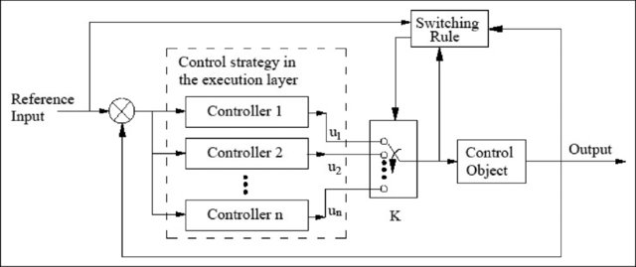
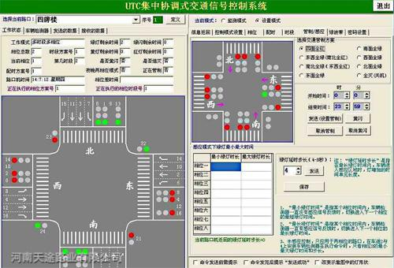
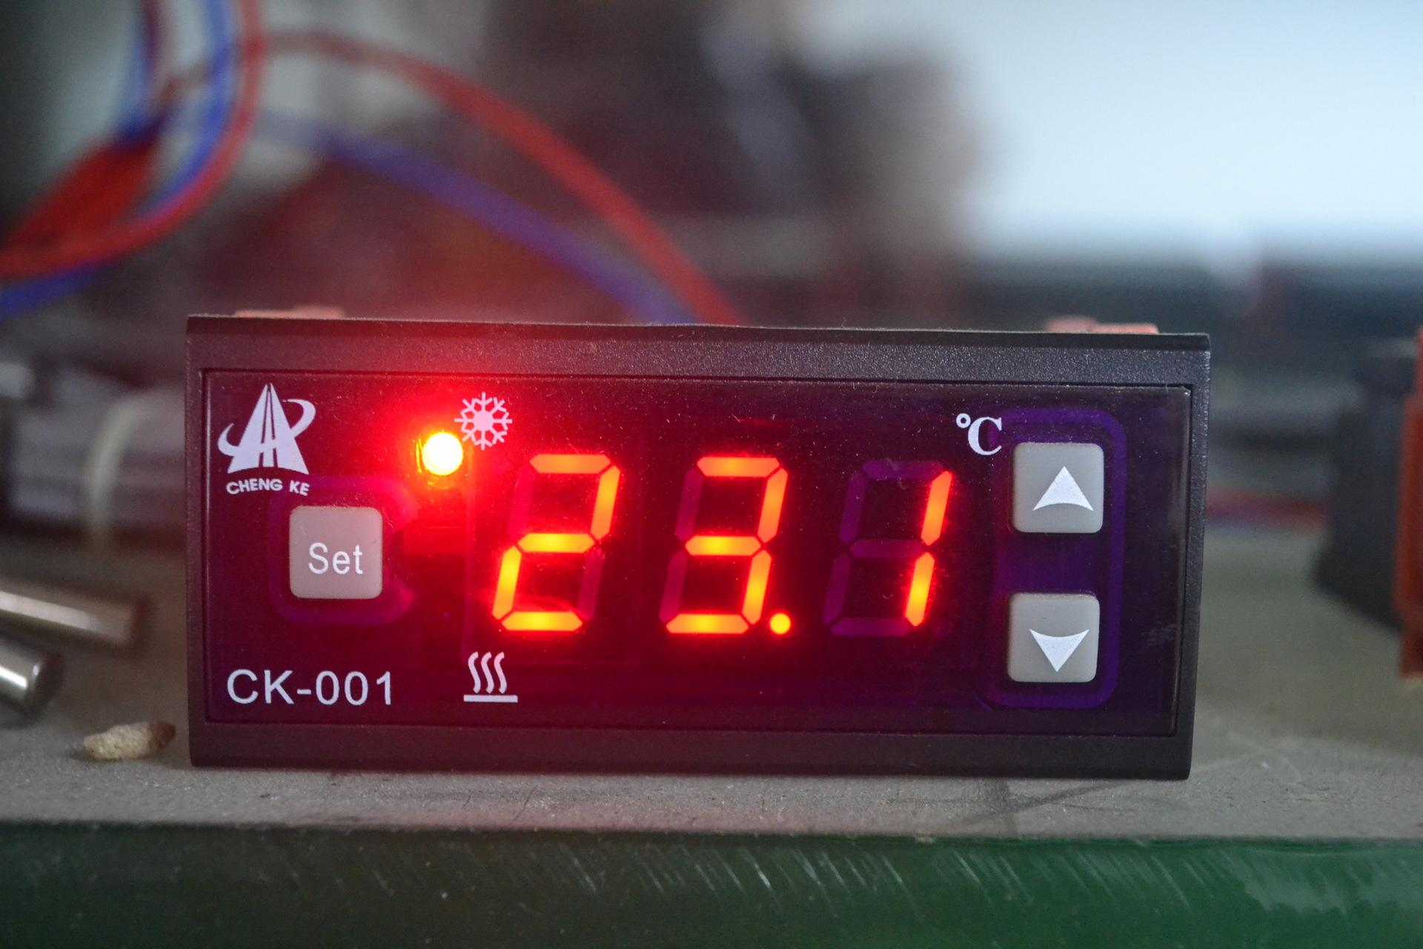

What is a switched system?
Switched systems comprise a family of dynamical systems orchestrated by a piece-wise constant switching signal
It provides a framework for modeling systems with transitions of dynamics and state jumps
Daily life examples: Air conditioner, refrigerator, auto gearbox, the smart traffic light systems, etc.
Control systems examples:
Supervision control of systems with large uncertainties;
Sampled-data control of cyber-physical systems
Event-triggered control
Quantized control

Slide 6
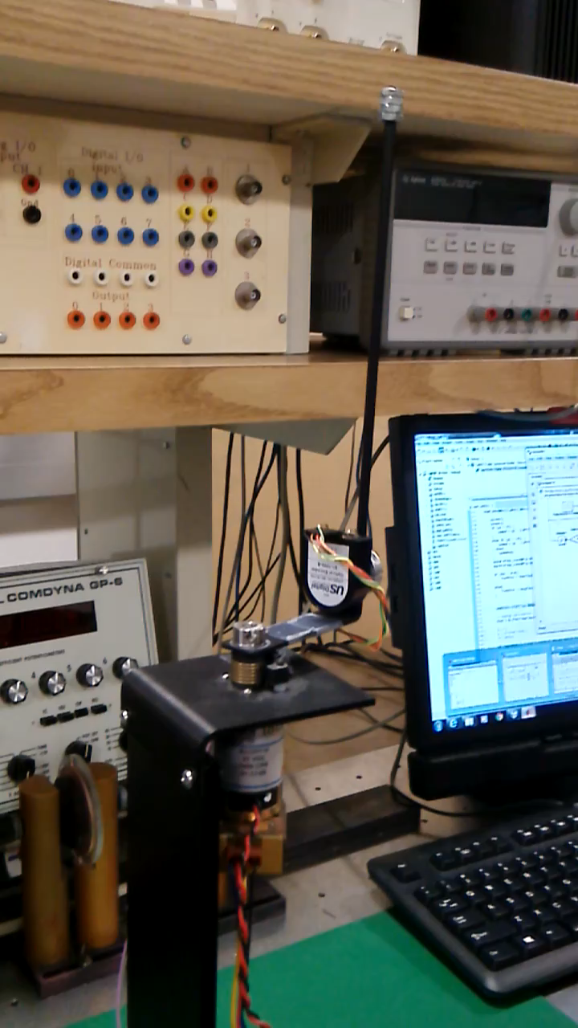
Why switching?
The model of switched systems capture rich dynamical behavior
Continuous-time systems not stabilizable via continuous state-feedback can be stabilized via switched control
Non-robust stability becomes robust
Switched feedback control improves performance
…

Slide 7
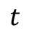
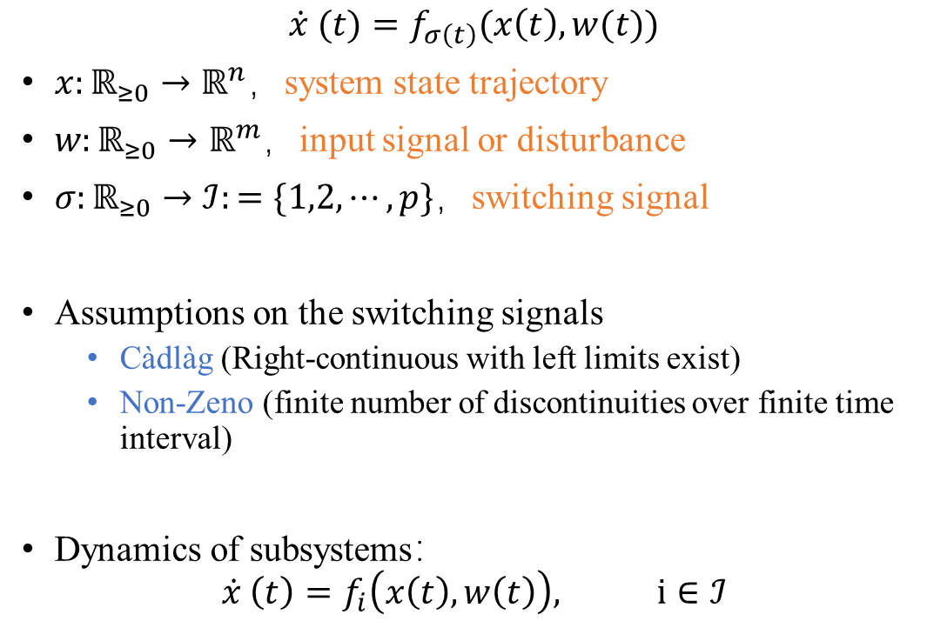
Definition of switched systems
$$\dot{x} (t)=f_{σ\left(t\right)}(x\left(t\right),w(t))$$
$x:ℝ_{≥0}→ℝ^{n}$，system state trajectory
$w:ℝ_{≥0}→ℝ^{m}$，input signal or disturbance
$σ:ℝ_{≥0}→ℐ:=\{1,2,⋯, p\}$，switching signal
Assumptions on the switching signals
Càdlàg (Right-continuous with left limits exist)
Non-Zeno (finite number of discontinuities over finite time interval)
Dynamics of subsystems：
$$\dot{x} \left(t\right)=f_{i}\left(x\left(t\right),w\left(t\right)\right), i∈ℐ$$
3
2
1
$$t$$

Slide 8
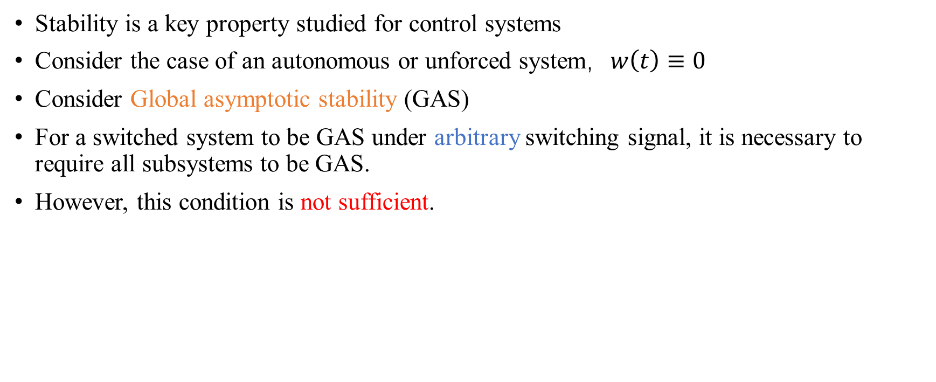
Feature of stability of switched system
Stability is a key property studied for control systems
Consider the case of an autonomous or unforced system，$w\left(t\right)≡0$
Consider Global asymptotic stability (GAS)
For a switched system to be GAS under arbitrary switching signal, it is necessary to require all subsystems to be GAS.
However, this condition is not sufficient.

Slide 9
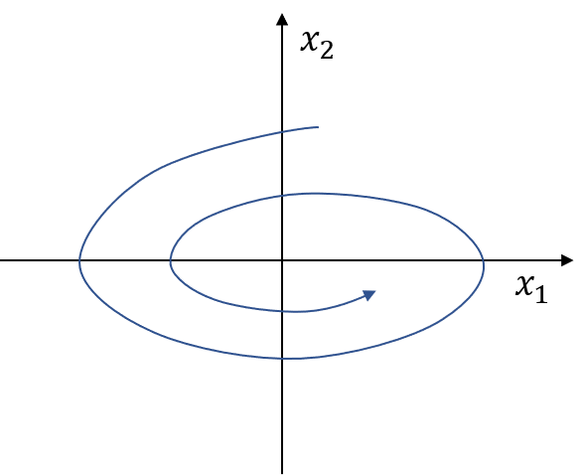
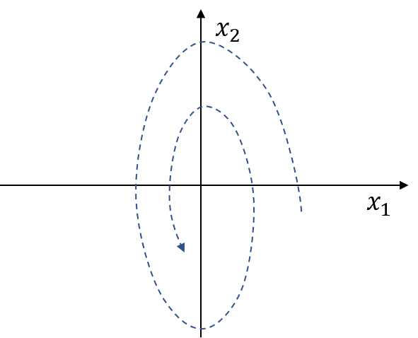
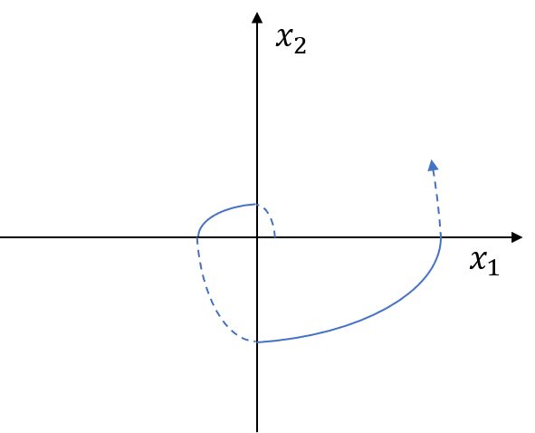
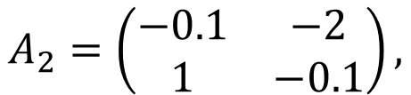
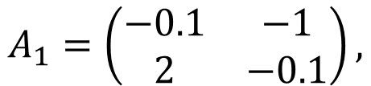
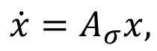
Conceptual example
Existence of a divergent solution of a switched system with both GAS subsystems.
$$\dot{x}=A_{σ}x,$$
$$A_{1}=\left(\begin{matrix}−0.1 & −1 \\ 2 & −0.1\end{matrix}\right),$$
$$A_{2}=\left(\begin{matrix}−0.1 & −2 \\ 1 & −0.1\end{matrix}\right),$$

Slide 10
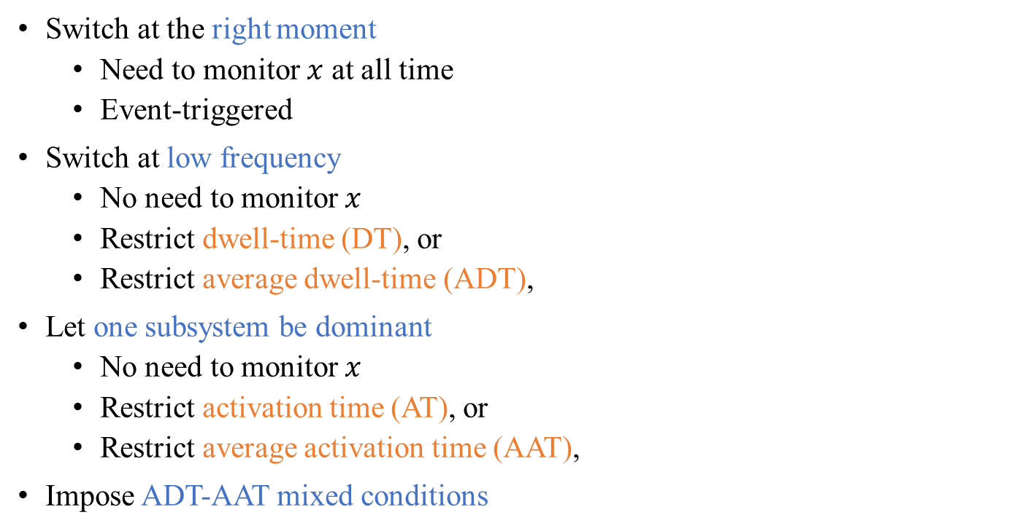
How to avoid instability?
Switch at the right moment
Need to monitor $x$ at all time
Event-triggered
Switch at low frequency
No need to monitor $x$
Restrict dwell-time (DT), or
Restrict average dwell-time (ADT),
Let one subsystem be dominant
No need to monitor $x$
Restrict activation time (AT), or
Restrict average activation time (AAT),
Impose ADT-AAT mixed conditions
State-dependent
Time-dependent

Slide 11
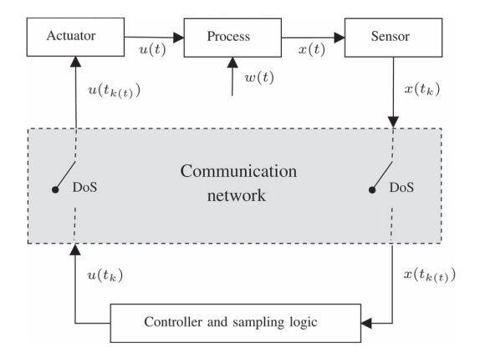
Control system example:
A networked, sample-data cyber-physical system, subjected to denial-of-service (DoS) attack.
DoS attack in the communication network is modeled by its frequency (~DT or ADT), and its duty ratio (~AT or AAT).
De Persis & Tesi. TAC, 2015.

Slide 12

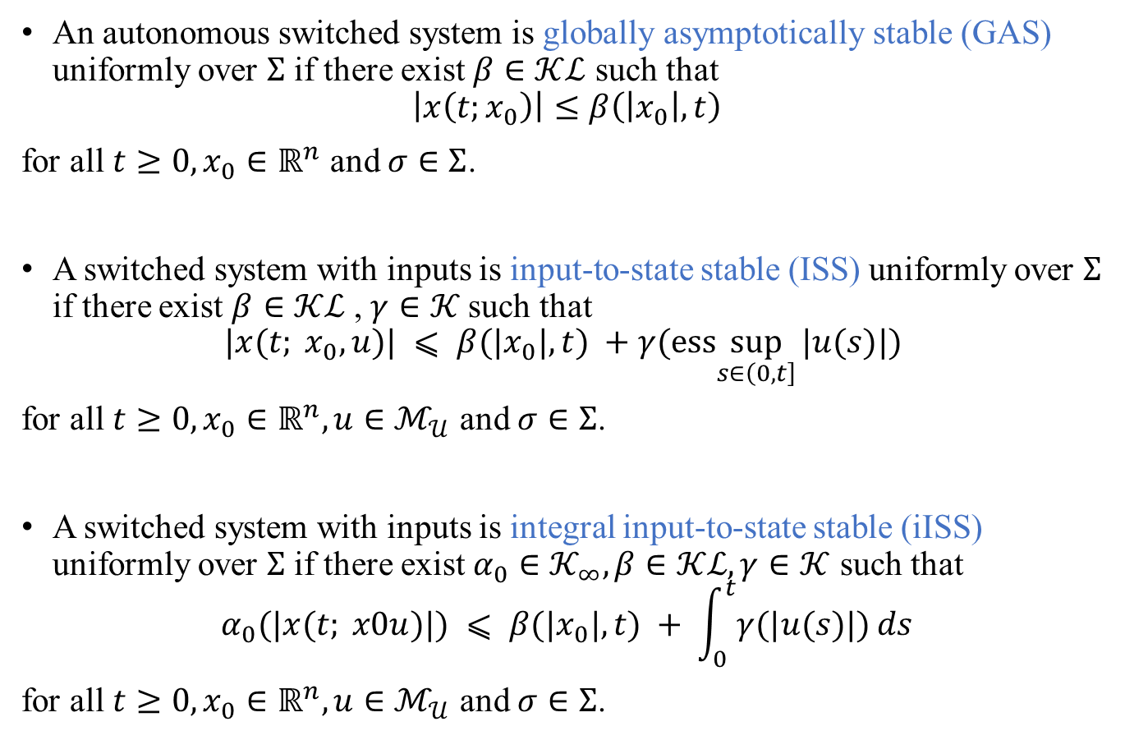



Recap of stability definitions
An autonomous switched system is globally asymptotically stable (GAS) uniformly over $Σ$ if there exist $β∈𝒦ℒ$ such that
$$\left|x\left(t;x_{0}\right)\right|≤β\left(\left|x_{0}\right|,t\right)$$
for all $t≥0, x_{0}∈ℝ^{n}$ and $σ∈Σ$.
A switched system with inputs is input-to-state stable (ISS) uniformly over $Σ$ if there exist $β∈𝒦ℒ$ , $γ∈𝒦$such that
$$|x(t; x_{0}, u)| ⩽ β(|x_{0}|, t) +γ(ess\sup_{s∈\left(0,t\right]}⁡|u(s)|)$$
for all $t≥0, x_{0}∈ℝ^{n},u∈ℳ_{𝒰}$ and $σ∈Σ$.
A switched system with inputs is integral input-to-state stable (iISS) uniformly over $Σ$ if there exist $α_{0}∈𝒦_{∞}, β∈𝒦ℒ, γ∈𝒦$ such that
$$α_{0}(|x(t; x0u)|) ⩽ β(|x_{0}|, t) + \int_{0}^{t}{γ(|u(s)|)}ds$$
for all $t≥0, x_{0}∈ℝ^{n},u∈ℳ_{𝒰}$ and $σ∈Σ$.
$$𝒫𝒟$$
$$𝒦$$
$$𝒦_{∞}$$
$$ℒ$$

Slide 13
Outline
Switched system overview
Deterministic stability
Stability/stabilization via ADT/AAT switching
General ISS/iISS switching signals for switched systems with nonlinear supply functions
Application study: data-driven approach for online stabilization of unknown switched linear systems
Stochastic stability
GAS a.s. via ADT/AAT conditions
Asymptotic moment stability via studying auxiliary linear time-delay system
Conclusion and future work

Slide 14
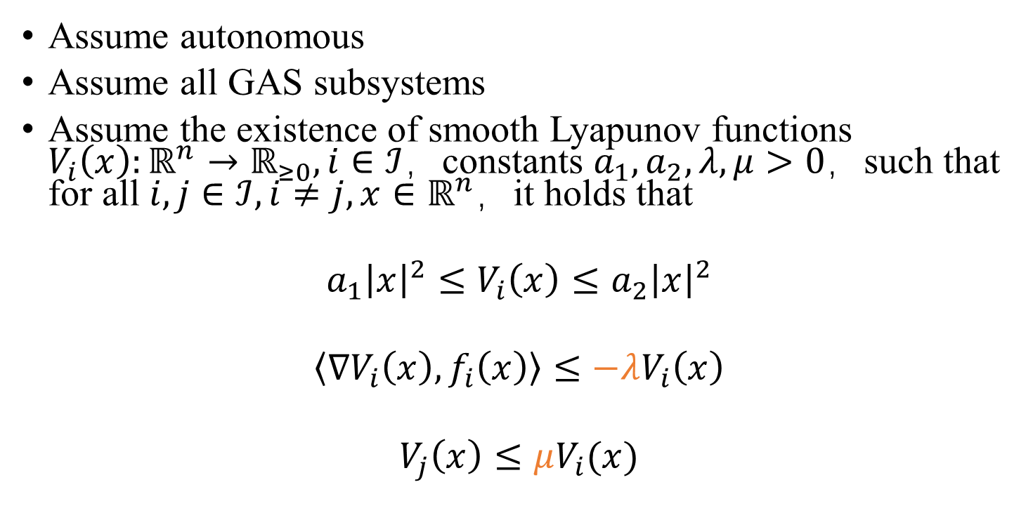
ADT condition
Assume autonomous
Assume all GAS subsystems
Assume the existence of smooth Lyapunov functions $V_{i}\left(x\right):ℝ^{n}→ℝ_{≥0}, i∈ℐ$，constants $a_{1},a_{2},λ,μ>0$，such that for all $i,j∈ℐ, i≠j, x∈ℝ^{n}$，it holds that
$$a_{1}{\left|x\right|}^{2}≤V_{i}\left(x\right)≤a_{2}{\left|x\right|}^{2}$$
$$\left\langle ∇V_{i}\left(x\right),f_{i}\left(x\right)\right\rangle ≤−λV_{i}\left(x\right)$$
$$V_{j}\left(x\right)≤μV_{i}(x)$$
Linear supply functions

Slide 15
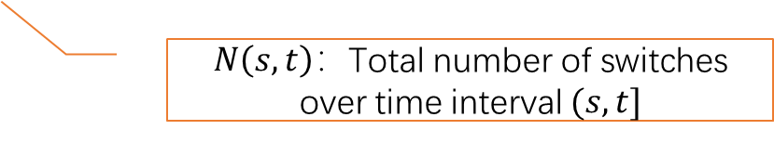
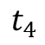
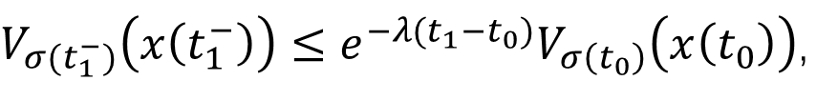

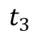
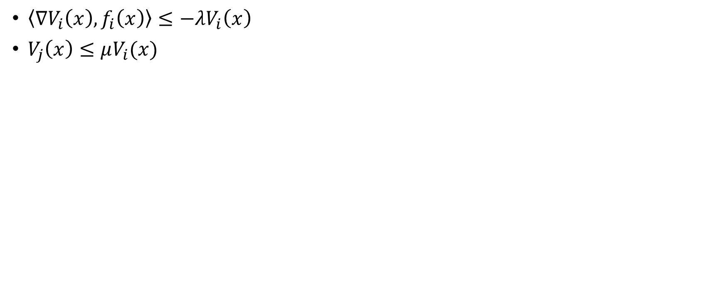
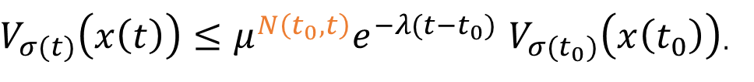
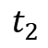
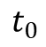
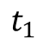
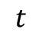
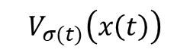
$\left\langle ∇V_{i}\left(x\right),f_{i}\left(x\right)\right\rangle ≤−λV_{i}\left(x\right)$
$V_{j}\left(x\right)≤μV_{i}(x)$
$V_{σ(t_{1}^{−})}\left(x\left(t_{1}^{−}\right)\right)≤e^{−λ{(t}_{1}−t_{0})}V_{σ\left(t_{0}\right)}\left(x\left(t_{0}\right)\right)$,
$V_{σ(t_{1})}\left(x\left(t_{1}\right)\right)≤μV_{σ\left(t_{1}^{−}\right)}\left(x\left(t_{1}^{−}\right)\right)≤μe^{−λ(t_{1}−t_{0})}V_{σ(t_{0})}\left(x\left(t_{0}\right)\right)$,
$V_{σ(t_{2}^{−})}\left(x\left(t_{2}^{−}\right)\right)≤{e^{−λ\left(t_{2}−t_{1}\right)}V}_{σ\left(t_{1}\right)}\left(x\left(t_{1}\right)\right)≤{μe}^{−λ{(t}_{2}−t_{0})}V_{σ(t_{0})}\left(x\left(t_{0}\right)\right)$,
$$⋯$$
$V_{σ(t)}\left(x\left(t\right)\right)≤μ^{N\left(t_{0},t\right)}e^{−λ(t−t_{0})}$ $V_{σ(t_{0})}\left(x\left(t_{0}\right)\right)$.
$N\left(s,t\right)：$Total number of switches over time interval $(s,t]$
$$V_{σ(t)}\left(x\left(t\right)\right)$$
$$t_{0}$$
$$t_{1}$$
$$t_{2}$$
$$t_{3}$$
$$t_{4}$$
$$t$$

Slide 16
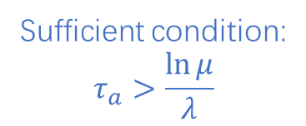
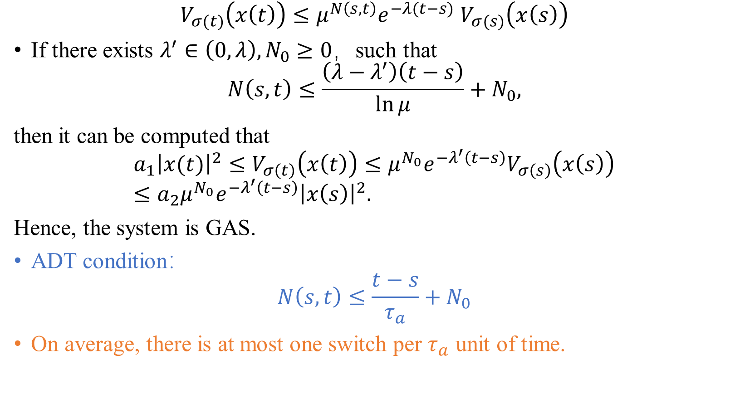
$V_{σ(t)}\left(x\left(t\right)\right)≤μ^{N\left(s,t\right)}e^{−λ(t−s)}$ $V_{σ(s)}\left(x\left(s\right)\right)$
If there exists $λ^{′}∈\left(0,λ\right), N_{0}≥0$，such that
$$N\left(s,t\right)≤\frac{\left(λ−λ^{′}\right)\left(t−s\right)}{\ln{μ}}+N_{0},$$
then it can be computed that
$$a_{1}{\left|x(t)\right|}^{2}≤V_{σ\left(t\right)}\left(x\left(t\right)\right)≤μ^{N_{0}}e^{−λ^{′}\left(t−s\right)}V_{σ\left(s\right)}\left(x\left(s\right)\right)≤a_{2}{μ^{N_{0}}e^{−λ^{′}\left(t−s\right)}\left|x\left(s\right)\right|}^{2}.$$
Hence, the system is GAS.
ADT condition：
$$N\left(s,t\right)≤\frac{t−s}{τ_{a}}+N_{0}$$
On average, there is at most one switch per $τ_{a}$ unit of time.
Sufficient condition:
$$τ_{a}>\frac{\ln{μ}}{λ}$$

Slide 17
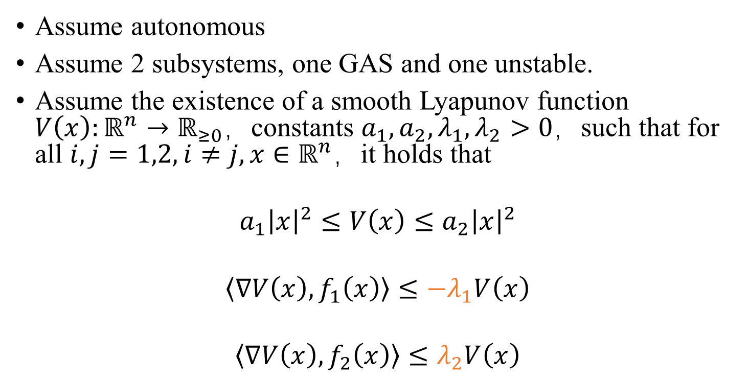
AAT condition
Assume autonomous
Assume 2 subsystems, one GAS and one unstable.
Assume the existence of a smooth Lyapunov function $V\left(x\right):ℝ^{n}→ℝ_{≥0}$，constants $a_{1},a_{2},λ_{1},λ_{2}>0$，such that for all $i,j=1,2, i≠j, x∈ℝ^{n}$，it holds that
$$a_{1}{\left|x\right|}^{2}≤V\left(x\right)≤a_{2}{\left|x\right|}^{2}$$
$$\left\langle ∇V\left(x\right),f_{1}\left(x\right)\right\rangle ≤−λ_{1}V\left(x\right)$$
$$\left\langle ∇V\left(x\right),f_{2}\left(x\right)\right\rangle ≤λ_{2}V\left(x\right)$$

Slide 18
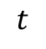
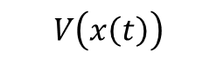
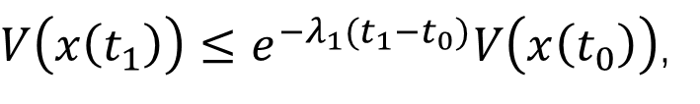
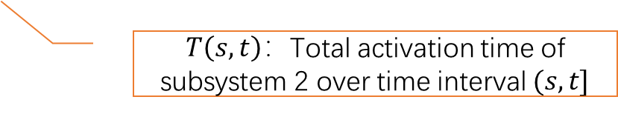
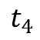
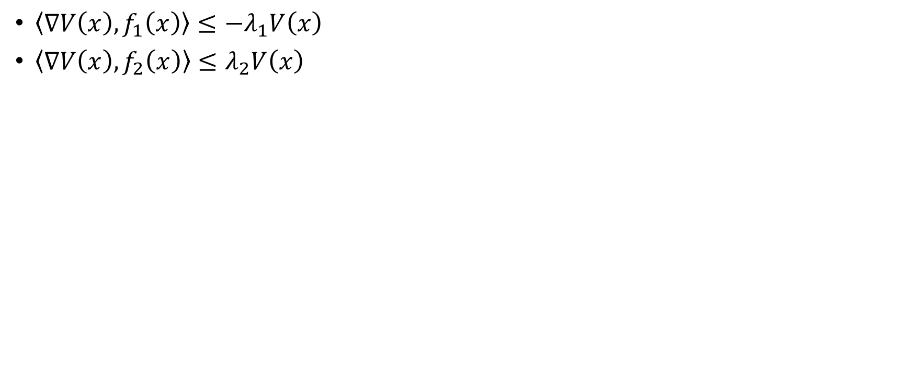

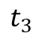
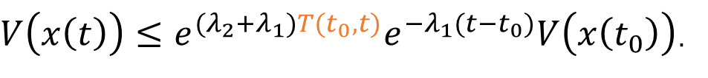
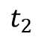
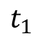
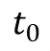
$\left\langle ∇V\left(x\right),f_{1}\left(x\right)\right\rangle ≤−λ_{1}V\left(x\right)$
$\left\langle ∇V\left(x\right),f_{2}\left(x\right)\right\rangle ≤λ_{2}V\left(x\right)$
$V\left(x\left(t_{1}\right)\right)≤e^{−λ_{1}{(t}_{1}−t_{0})}V\left(x\left(t_{0}\right)\right)$,
$V\left(x\left(t_{2}\right)\right)≤e^{λ_{2}\left(t_{2}−t_{1}\right)}V\left(x\left(t_{1}\right)\right)≤e^{{(λ}_{2}+λ_{1})(t_{2}−t_{1})}e^{−λ_{1}(t_{2}−t_{0})}V\left(x\left(t_{0}\right)\right)$,
$$⋯$$
$V\left(x\left(t\right)\right)≤e^{{(λ}_{2}+λ_{1})T(t_{0},t)}e^{−λ_{1}(t−t_{0})}V\left(x\left(t_{0}\right)\right)$.
$T\left(s,t\right)：$Total activation time of subsystem 2 over time interval $(s,t]$
$$V\left(x\left(t\right)\right)$$
$$t_{0}$$
$$t_{1}$$
$$t_{2}$$
$$t_{3}$$
$$t_{4}$$
$$t$$

Slide 19
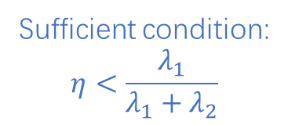
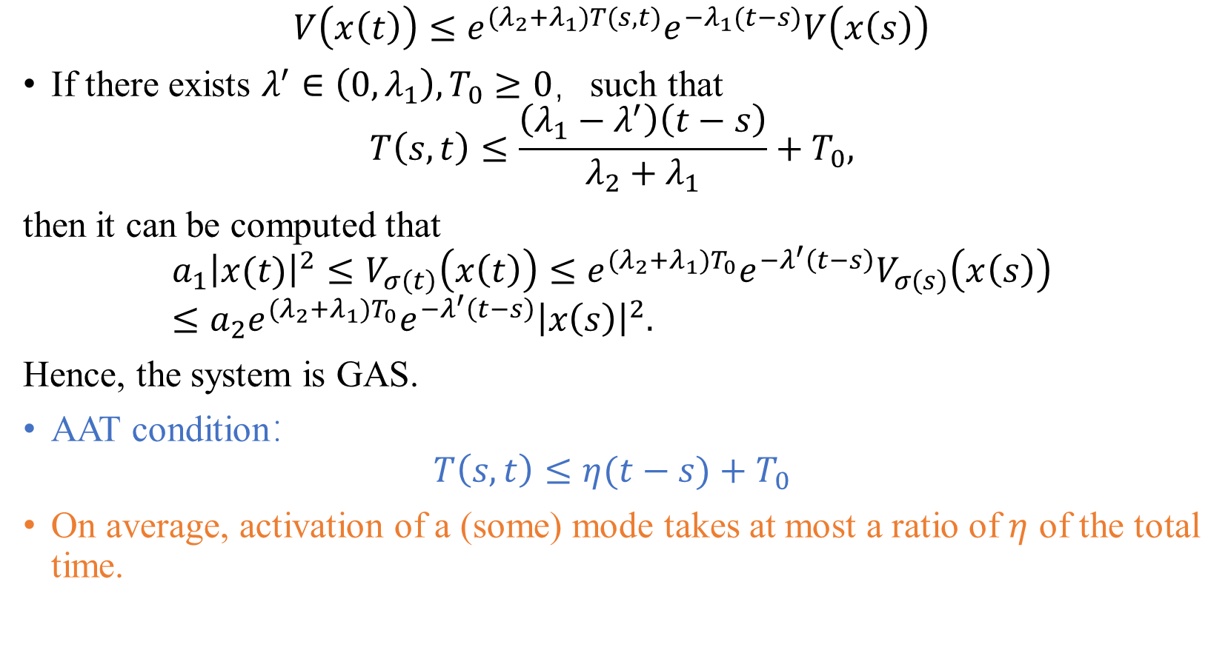
$$V\left(x\left(t\right)\right)≤e^{{(λ}_{2}+λ_{1})T(s,t)}e^{−λ_{1}(t−s)}V\left(x\left(s\right)\right)$$
If there exists $λ^{′}∈\left(0,λ_{1}\right), T_{0}≥0$，such that
$$T\left(s,t\right)≤\frac{\left(λ_{1}−λ^{′}\right)\left(t−s\right)}{λ_{2}+λ_{1}}+T_{0},$$
then it can be computed that
$$a_{1}{\left|x(t)\right|}^{2}≤V_{σ\left(t\right)}\left(x\left(t\right)\right)≤e^{{(λ}_{2}+λ_{1})T_{0}}e^{−λ^{′}\left(t−s\right)}V_{σ\left(s\right)}\left(x\left(s\right)\right)≤a_{2}{e^{{(λ}_{2}+λ_{1})T_{0}}e^{−λ^{′}\left(t−s\right)}\left|x\left(s\right)\right|}^{2}.$$
Hence, the system is GAS.
AAT condition：
$$T\left(s,t\right)≤η(t−s)+T_{0}$$
On average, activation of a (some) mode takes at most a ratio of $η$ of the total time.
Sufficient condition:
$$η<\frac{λ_{1}}{λ_{1}+λ_{2}}$$

Slide 20
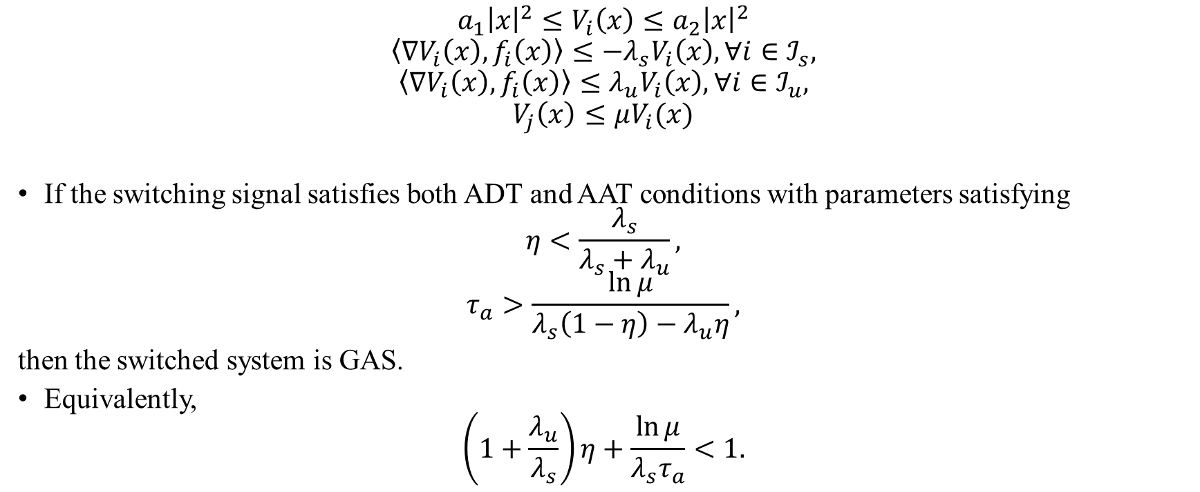
ADT-AAT mixed condition
$$a_{1}{\left|x\right|}^{2}≤V_{i}\left(x\right)≤a_{2}{\left|x\right|}^{2}$$
$$\left\langle ∇V_{i}\left(x\right),f_{i}\left(x\right)\right\rangle ≤−λ_{s}V_{i}\left(x\right), ∀i∈ℐ_{s},$$
$$\left\langle ∇V_{i}\left(x\right),f_{i}\left(x\right)\right\rangle ≤λ_{u}V_{i}\left(x\right),∀i∈ℐ_{u},$$
$$V_{j}\left(x\right)≤μV_{i}(x)$$
If the switching signal satisfies both ADT and AAT conditions with parameters satisfying
$$η<\frac{λ_{s}}{λ_{s}+λ_{u}},$$
$$τ_{a}>\frac{\ln{μ}}{λ_{s}\left(1−η\right)−λ_{u}η},$$
then the switched system is GAS.
Equivalently,
$$\left(1+\frac{λ_{u}}{λ_{s}}\right)η+\frac{\ln{μ}}{λ_{s}τ_{a}}<1.$$
Müller & Liberzon. Automatica, 2012

Slide 21
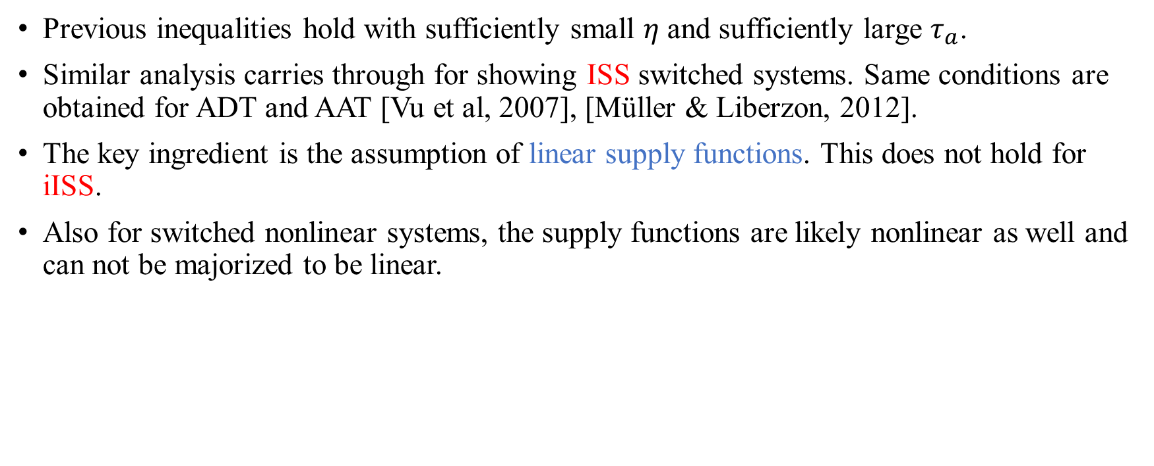
Remarks
Previous inequalities hold with sufficiently small $η$ and sufficiently large $τ_{a}$.
Similar analysis carries through for showing ISS switched systems. Same conditions are obtained for ADT and AAT [Vu et al, 2007], [Müller & Liberzon, 2012].
The key ingredient is the assumption of linear supply functions. This does not hold for iISS.
Also for switched nonlinear systems, the supply functions are likely nonlinear as well and can not be majorized to be linear.

Slide 22
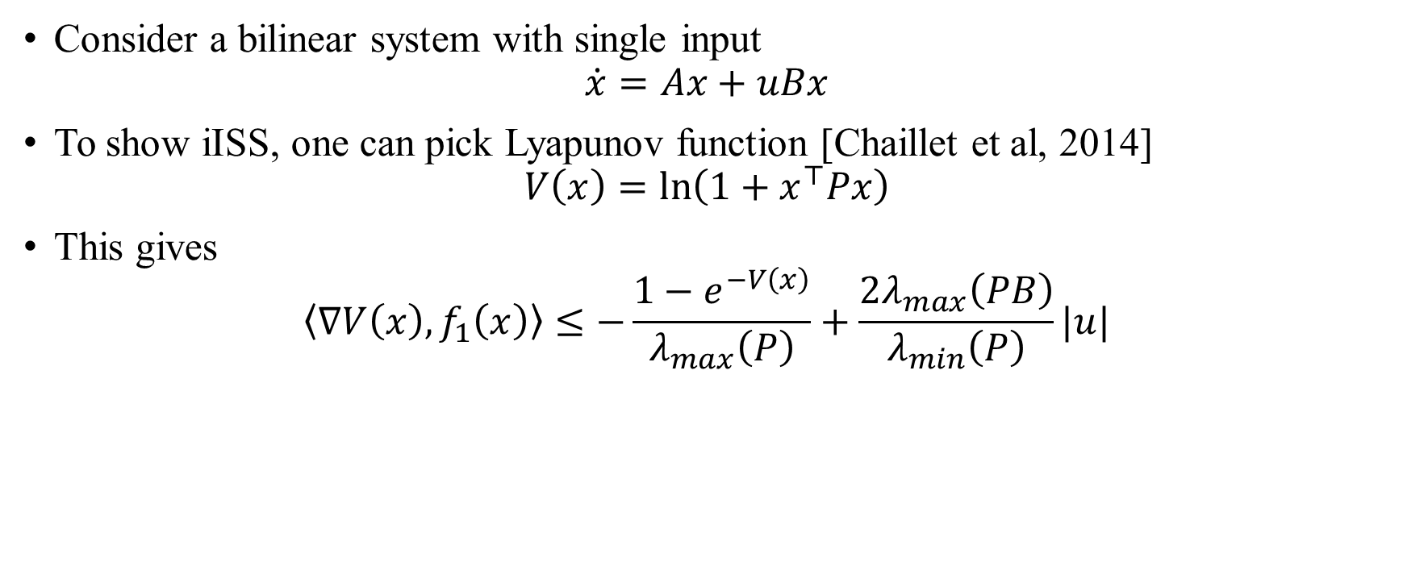
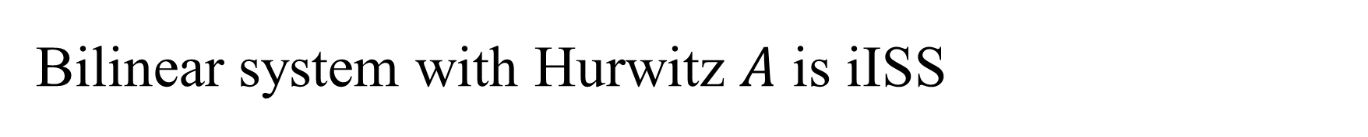
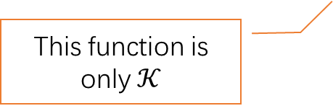
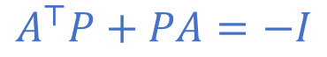
Bilinear system with Hurwitz $A$ is iISS
Consider a bilinear system with single input
$$\dot{x}=Ax+uBx$$
To show iISS, one can pick Lyapunov function [Chaillet et al, 2014]
$$V\left(x\right)=\ln\left(1+x^{⊤}Px\right)$$
This gives
$$\left\langle ∇V\left(x\right),f_{1}\left(x\right)\right\rangle ≤−\frac{{1−e}^{−V\left(x\right)}}{λ_{max}\left(P\right)}+\frac{2λ_{max}\left(PB\right)}{λ_{min}\left(P\right)}|u|$$
$$A^{⊤}P+PA=−I$$
This function is only $𝒦$

Slide 23
Outline
Switched system overview
Deterministic stability
Stability/stabilization via ADT/AAT switching
General ISS/iISS switching signals for switched systems with nonlinear supply functions
Application study: data-driven approach for online stabilization of unknown switched linear systems
Stochastic stability
GAS a.s. via ADT/AAT conditions
Asymptotic moment stability via studying auxiliary linear time-delay system
Conclusion and future work

Slide 24



Non-trivial examples
Switched systems which are not GAS under ADT switching signals, no matter how slowly it switches.
$\dot{x}={{\left|x\right|}^{2}A}_{σ}x,$or $\dot{x}=\frac{1}{1+{\left|x\right|}^{2}}A_{σ}x,$
$$A_{1}=\left(\begin{matrix}−0.1 & −1 \\ 2 & −0.1\end{matrix}\right),$$
$$A_{2}=\left(\begin{matrix}−0.1 & −2 \\ 1 & −0.1\end{matrix}\right),$$
[A],
Della Rossa & Tanwani. SCL 2022

Slide 25
Motivation
There are examples of switched systems with nonlinear supply functions, which are not GAS, ISS or iISS uniformly over any class of ADT switching signals
Questions:
What weaker stability properties do such systems have?
[A], [C]
Are there switched systems with nonlinear supply functions that are GAS, ISS or iISS uniformly over ADT switching signals? What are the sufficient conditions?
[B]
Does there exist a more restrictive class of switching signals, uniformly over which the aforementioned systems with nonlinear supply functions are GAS, ISS or iISS?
Liu, Tanwani, Liberzon, in preparation

Slide 26

Weaker stability properties
The switched system is quasi-iISS (qiISS) under slow switching if for all $δ_{1},δ_{2}>0$, there exist a dwell time $τ_{d}>0$ and functions $β∈𝒦ℒ$, $α_{0},γ∈𝒦_{∞}$ such that
$$α_{0}\left(\left|x\left(t;x_{0},u\right)\right|\right)≤β\left(\left|x_{0}\right|,t\right)+\int_{0}^{t}{γ\left(\left|u\left(τ\right)\right|\right)dτ}$$
for all $t≥0, \left|x_{0}\right|≤δ_{1}, \int_{0}^{t}{γ\left(\left|u\left(τ\right)\right|\right)dτ}≤δ_{2}$.
The switched system is integral-input-to-state practically stable (iISpS) under slow switching if for each $δ_{3}>0$, there exist a dwell time $τ_{d}>0$ and functions $β∈𝒦ℒ$, $α_{0},γ∈𝒦_{∞}$ such that
$$α_{0}\left(\left|x\left(t;x_{0},u\right)\right|\right)≤β\left(\left|x_{0}\right|,t\right)+\int_{0}^{t}{γ\left(\left|u\left(τ\right)\right|\right)dτ}+δ_{3}$$
for all $t≥0, x_{0}∈ℝ^{n}, u∈ℳ_{𝒰}$.

Slide 27
Weaker stability properties
The work [A] proposes DT conditions for a switched nonlinear system to be qiISS or iISpS.
Using these conditions, the aforementioned examples, after adding disturbance, are proven qiISS and iISpS, respectively.
We also show that, a switched system is iISS if and only if it is both qiISS and iISpS.
Similar results are also carried out for ISS [C] but done in the hybrid system framework.

Slide 28

Lyapunov characterization via nonlinear supply functions
Assume the existence of smooth Lyapunov functions $V_{i}\left(x\right):ℝ^{n}→ℝ_{≥0}, i∈ℐ,$ functions $α_{1}, α_{2}, χ∈𝒦_{∞},$ $α_{s},α_{u}∈𝒫𝒟,$ $γ∈𝒦,$ such that for all $i,j∈ℐ, i≠j, x∈ℝ^{n},$ it holds that
$$α_{1}\left(\left|x\right|\right)≤V_{i}\left(x\right)≤α_{2}\left(\left|x\right|\right),$$
$$\left\langle ∇V_{i}\left(x\right),f_{i}\left(x,u\right)\right\rangle ≤−α_{s}\left(V_{i}\left(x\right)\right)+γ\left(\left|u\right|\right) ∀i∈ℐ_{s},$$
$$\left\langle ∇V_{i}\left(x\right),f_{i}\left(x,u\right)\right\rangle ≤α_{u}\left(V_{i}\left(x\right)\right)+γ\left(\left|u\right|\right) ∀i∈ℐ_{u},$$
$$V_{j}(x)≤χ(V_{i}(x))$$
The subsystems with index $i∈ℐ_{s}$ are iISS.
If $α_{s},α_{u}∈𝒦_{∞},$ then those subsystems are ISS.
A mild assumption: $α_{s}$ is one-sided globally Lipschitz.

Slide 29

Sufficient conditions for ISS and iISS
Define
$$κ:=\sup_{r>0}{\frac{α_{u}(r)}{α_{s}(r)}}, ζ:=\sup_{r>0}{\int_{r}^{χ(r)}{\frac{1}{α_{s}(r)}dr}}.$$
Stability result: The switched system is iISS uniformly over all switching signals satisfying ADT-AAT conditions, with parameters satisfying
$$\left(1+κ\right)η+\frac{ζ}{τ_{a}}<1.$$
Moreover, if $α_{s},α_{u}∈𝒦_{∞}$, then the switched system is ISS uniformly over the same class of switching signals.
[B]

Slide 30

Sketch of the proof
The proof is evolved in the framework of hybrid systems
Construct hybrid timers for dealing with ADT and AAT conditions
Define a hybrid Lyapunov function
$$V\left(ξ\right)≔φ^{−1}\left(e^{2c\left(ζτ+\left(κ+1\right)\left(T_{0}−τ_{u}\right)\right)}φ\left(V_{p}\left(x\right)\right)\right),$$
where
$$φ\left(s\right)≔\left\{\begin{matrix}e^{\int_{1}^{s}{\frac{2c}{α_{s}(r)}dr}}, & if s>0, \\ 0, & if s=0.\end{matrix}\right.$$
Show (1) a sandwich condition, (2) dissipative along flow maps (3) dissipative along jump maps for the hybrid Lyapunov function $V$.

Slide 31

Observations
For switched system with linear supply functions, the condition becomes
$$\left(1+\frac{λ_{u}}{λ_{s}}\right)η+\frac{\ln{μ}}{λ_{s}τ_{a}}<1,$$
same as [Müller & Liberzon, 2012].
Using this theorem, switched bilinear systems is shown iISS under slow switching.
Autonomous linear systems, linear systems with linear inputs, bilinear systems are fundamentally alike:
If a condition on ADT, AAT guarantees a GAS autonomous switched linear system, then it also guarantees ISS switched linear system with linear inputs and iISS switched bilinear system with the same $A_{i}$ matrices.

Slide 32
Outline
Switched system overview
Deterministic stability
Stability/stabilization via ADT/AAT switching
General ISS/iISS switching signals for switched systems with nonlinear supply functions
Application study: data-driven approach for online stabilization of unknown switched linear systems
Stochastic stability
GAS a.s. via ADT/AAT conditions
Asymptotic moment stability via studying auxiliary linear time-delay system
Conclusion and future work

Slide 33

Why data-driven
Space of all systems
Control a system without knowing the exact system parameters
For a linear discrete-time system
$$x(t+1)=Ax(t)+Bu(t),$$
one does not need to collect as many data $x\left(t\right), u(t)$ as for identification of $A,B$, in order to design a stabilizing feedback law
$$u(t)=Kx(t)$$
Data informativity [van Waarde et al, TAC 2020]
Systems compatible with the collected data

Slide 34

Data-driven online stabilization
$x\left(t+1\right)={\hat{A}}_{σ\left(t\right)}x\left(t\right)+{\hat{B}}_{σ\left(t\right)}u\left(t\right) σ:ℕ→ℐ$
$A_{i}, B_{i}$ are all unknown.
$σ$ is also unknown (but satisfies some DT/ADT conditions).
Design a control law $u\left(t\right)$ to stabilize the switched system.

Slide 35

Existing algorithm
At each time instant $t$, the algorithm solves a semidefinite program (SDP) based on data collected over a finite window, and hence find a state feedback law $u\left(t\right)=Kx(t)$.
If there is a switch in the window, then the computed gain $K$ does not help stabilizing the system.
Window size needs to be large. Past data is discarded; the algorithm updates $K$ as if it has no previous knowledge about the system at all.
In order to mitigate such problems, the switching needs to be very slow so that most of the time, the system dwells in a single mode over the finite window.
SDP at each time instant makes the algorithm inefficient.
Rotulo et al, Automatica, 2022

Slide 36

Our algorithm
Initialization phase: collect a minor amount of data for finding a $K_{i}$ for each mode $i$.
Mode detection phase: use data compatibility condition for detecting the current mode.
Stabilizing phase: apply $u\left(t\right)=K_{σ_{d}}x\left(t\right)$, where $σ_{d}$ is the detected mode from mode detection phase.
Initialization
Mode detection
Triggering condition met?
Mode detected?
Stabilization

Slide 37


Advantages of our approach
$$V_{σ_{d}}\left(x\left(t+1\right)\right)>λV_{σ_{d}}\left(x\left(t\right)\right)$$
Mode detection scheme
Triggering condition (noiseless)

Slide 38

Stability analysis
Each stabilizing phase is a stable subsystem
Each mode detection phase is an unstable subsystem
Stability can be analyzed via ADT-AAT conditions
The results show that our approach allows switching signals with much faster switching.
[C]

Slide 39

A numerical example with 5 states, 3 inputs, and 5 modes

Slide 40
Outline
Switched system overview
Deterministic stability
Stability/stabilization via ADT/AAT switching
General ISS/iISS switching signals for switched systems with nonlinear supply functions
Application study: data-driven approach for online stabilization of unknown switched linear systems
Stochastic stability
GAS a.s. via ADT/AAT conditions
Asymptotic moment stability via studying auxiliary linear time-delay system
Conclusion and future work

Slide 41
Stochastic vs deterministic
Unlike deterministic switching signals, a stochastic switching signal can have random switches.
Frequency of switches and activation time of modes are also random.
ADT, AAT conditions becomes unsuitable.
However, expectations of dwell time and activation time still make sense.
ADT, AAT conditions can be imposed on these expectations.

Slide 42

Markovian/semi-Markovian switched systems
Dynamics is the same as deterministic switched systems
Switching signals are generated by Markov/semi-Markov processes: $σ∼SM\left(p^{o},Π,Ψ\right),$
$p^{o}∈ℝ^{p}$, initial probability vector
$Π∈ℝ^{p×p}$, mode-transition probability matrix
$Ψ=\{ψ_{1},…,ψ_{p}\}$, sojourn time distribution functions
$$P\left(σ\left(t_{0}\right)=i\right)=p_{i}^{o},$$
$$P\left(σ\left(t_{k}\right)=j | σ\left(t_{0}\right),…σ\left(t_{k−1} \right),Δt_{1},…Δt_{k−1}\right)=P\left(σ\left(t_{k}\right)=j | σ\left(t_{k−1}\right)\right)=π_{σ\left(t_{k−1}\right)j},$$
$$P\left(Δt_{k}≤t | σ\left(t_{0}\right),…σ\left(t_{k−1} \right),Δt_{1},…Δt_{k−1}\right)=P\left(Δt_{k}≤t | σ\left(t_{k−1}\right)\right)=ψ_{σ\left(t_{k−1}\right)}(t)$$
If all $ψ_{i}$ are exponential distributions, then it reduces to Markov process.

Slide 43

Stochastic stability definitions
Almost sure global asymptotic stability (GAS a.s.):
$$P\left(\lim_{t→∞}\left|x\left(t;x_{0}\right)\right|=0\right)=1$$
Asymptotic $m$-th moment stability: there exists $β∈𝒦ℒ$ such that
$$E\left({\left|x\left(t;x_{0}\right)\right|}^{m}\right)≤β(\left|x_{0}\right|,t)$$
When $m=1$ or $2$, they are also known as asymptotic mean stability or asymptotic mean-square stability.

Slide 44

GAS a.s. via ADT and AAT
Compute expected dwell time and activation time:
Let $v∈ℝ^{p}$ be the left Perron vector of $Π$. This eigenvector tells the steady state of the discrete-time Markov process with transition matrix $Π$.
Expected dwell time of subsystem $i$:
$$E_{i}=\int_{0}^{∞}{τψ_{i}^{′}\left(τ\right)dτ}$$
Expected switching period:
$$τ_{a}=\sum_{i=1}^{p}{v_{i}E_{i}}$$
Expected activation time of subsystem $i$:
$$η_{i}=\frac{v_{i}E_{i}}{\sum_{i=1}^{p}{v_{i}E_{i}}}$$
Stability result: if it holds that
$$\left(1+\frac{λ_{u}}{λ_{s}}\right)η+\frac{\ln{μ}}{λ_{s}τ_{a}}<1,$$
then the switched system is GAS a.s.
The proof uses ergodicity theory.
[Wu et al. TAC 2018]

Slide 45


Is GAS a.s. a good measure?
Consider a 2-mode, 1-dimensional, switched linear system
$$\dot{x}=0.25x, σ\left(t\right)=1,$$
$$\dot{x}=−0.3x, σ\left(t\right)=2.$$
$p^{o}=\left[\begin{matrix}1 \\ 0\end{matrix}\right], Π=\left[\begin{matrix}0 & 1 \\ 1 & 0\end{matrix}\right], ψ_{1}\left(t\right)=ψ_{2}\left(t\right)=1−e^{−t}.$

Slide 46

Is GAS a.s. a good measure?
GAS a.s. is an asymptotic property, not satisfactory in the prediction of $|x\left(t\right)|$ when $t$ is finite.
It cannot reflect the statistical behavior of $x(t)$.
GAS a.s. is different to asymptotic moment stability, and asymptotic moment stability differs with respect to different degrees of moment.

Slide 47
Outline
Switched system overview
Deterministic stability
Stability/stabilization via ADT/AAT switching
General ISS/iISS switching signals for switched systems with nonlinear supply functions
Application study: data-driven approach for online stabilization of unknown switched linear systems
Stochastic stability
GAS a.s. via ADT/AAT conditions
Asymptotic moment stability via studying auxiliary linear time-delay system
Conclusion and future work

Slide 48

Assumptions on sojourn time distributions
For all $i∈ℐ$, $ψ_{i}(t)$ is continuous and $\left(l+1\right)$-times piece-wise continuously differentiable.
High-order “derivative” of $ψ_{i}$: $ψ_{i}^{(0)}\left(t\right):=ψ_{i}(t)$ and for each $k=0,1,…,l,$
$$ψ_{i}^{\left(k+1\right)}\left(t\right)≔\lim_{s→t^{+}}{\frac{d}{ds}ψ_{i}^{\left(k\right)}\left(s\right)}.$$
$ψ_{i}^{\left(k+1\right)}\left(t\right)$ is the “derivative” of $ψ_{i}^{\left(k\right)}\left(t\right)$, modulo the non-smoothness and discontinuities.
Define
$$𝒯_{i}^{(k)}≔\{0\}∪\left\{τ>0:ψ_{i}^{\left(k\right)}\left(τ\right)≠ψ_{i}^{\left(k\right)}\left(τ^{−}\right)\right\},$$
$$Δψ_{i}^{\left(k\right)}\left(t\right)≔\left\{\begin{matrix}ψ_{i}^{\left(k\right)}\left(t\right)≠ψ_{i}^{\left(k\right)}\left(t^{−}\right) & if t>0, \\ ψ_{i}^{\left(k\right)}(0) & if t=0.\end{matrix}\right.$$

Slide 49

Assumptions on sojourn time distributions
Assumption 1: For each $i∈ℐ$, there exist $κ_{i}^{\left(1\right)},κ_{i}^{(2)},…,κ_{i}^{\left(l\right)}∈ℝ$ such that
$$ψ_{i}^{\left(l+1\right)}\left(t\right)=\sum_{k=1}^{l}{κ_{i}^{\left(k\right)}ψ_{i}^{\left(k\right)}\left(t\right)}.$$
Assumption 2: The set
$$𝒯_{Ψ}≔∪_{i∈ℐ}∪_{k=1}^{l}𝒯_{i}^{\left(k\right)}$$
is finite. Moreover, $\lim_{t→∞}ψ_{i}^{k}\left(t\right)=0$ for all $i∈ℐ$, $k=1,…l$.
These assumptions hold for standard distributions; e.g., exponential, uniform, trigonometric, Gamma (with integer shape parameter) distributions, etc.

Slide 50


Slide 51

Lyapunov functions assumption
Assumption 3: There exist smooth functions $V_{i}\left(x\right):ℝ^{n}→ℝ_{≥0}, i∈ℐ$, functions $α_{1},α_{2}∈𝒦_{∞}$ and parameters $λ_{1},…,λ_{p}∈ℝ$, $U=\left[μ_{ij}\right]∈ℝ_{≥0}^{p×p}$ such that for all $x∈ℝ^{n}, i,j,k∈ℐ,$ it holds that
$$α_{1}\left(\left|x\right|\right)≤V_{i}\left(x\right)≤α_{2}\left(\left|x\right|\right),$$
$$\left\langle ∇V_{i}\left(x\right), f_{i}\left(x\right)\right\rangle ≤λ_{i}V_{i}\left(x\right),$$
$$V_{k}\left(x\right)≤μ_{jk}V_{j}\left(x\right).$$

Slide 52

Sufficient condition for asymptotic moment stability
Consider a semi-Markovian switched system with $p$ modes, where its switching signal $σ∼SM\left(p^{o}, Π,Ψ\right)$. Suppose all Assumptions 1,2,3 hold. Then it holds that
$$E\left(α_{1}\left(\left|x\left(t;x_{0}\right)\right|\right)\right)≤y\left(t\right)α_{2}\left(\left|x_{0}\right|\right),$$
where $y(t)$ is the single output of the $(lp)$-dimensional linear time-delay system
$$\begin{matrix}\dot{z}\left(t\right)=\sum_{s∈𝒯_{Ψ}∩[0,t]}{A\left(s\right)z\left(t−s\right)+\sum_{𝒯_{Ψ}∩(t,∞)}{b(s,t)}}, \\ y\left(t\right)={\left(p^{o}\right)}^{⊤}\left[I_{p} 0_{p×\left(l−1\right)p}\right]z\left(t\right).\end{matrix}$$
[F]

Slide 53


$$A\left(s\right)=\left\{\begin{matrix}\overline{Λ}+\overline{K}+\overline{C}(0) & if s=0, \\ \overline{C}(s) & if s>0,\end{matrix}\right.$$

Slide 54

Remarks
This theorem establishes a close relationship between the asymptotic moment stability of a semi-Markovian switched system and GAS of an auxiliary linear time-delay system.
The semi-Markovian switched system is asymptotic $m$-th moment stable if the auxiliary linear time-delay system is GAS, and there exists $a_{0}>0$ such that
$$α_{1}\left(s\right)≥a_{0}s^{m} ∀s≥0.$$
The result is tight, in the sense that if all the inequalities in the Lyapunov functions assumption are replaced by equality, then the inequality in the estimation of moment expectation can also be replaced by equality.

Slide 55

Remarks
The tightness comes from the novel derivation, which involves formulating a general multi-mode renewal equation, where no relaxations are introduced.
In the case of Markovian switched system (so that the sojourn time distributions are all exponential, $𝒯_{Ψ}=∅$), the auxiliary system has no delay and is simply LTI.
Thus, it is sufficient to check whether the matrix $A(0)$ is Hurwitz for showing asymptotic moment stability.

Slide 56

Special case: 2-mode Markovian switched system
$$A\left(0\right)=\left[\begin{matrix}λ_{1}−q_{1} & μ_{12}q_{1} \\ μ_{21}q_{2} & λ_{2}−q_{2}\end{matrix}\right]$$
Necessary and sufficient condition for $A(0)$ to be Hurwitz:
$$λ_{1}+λ_{2}−q_{1}−q_{2}<0,$$
$$μ_{12}μ_{21}<\left(1−\frac{λ_{1}}{q_{1}}\right)\left(1−\frac{λ_{2}}{q_{2}}\right).$$
The second equation implies $μ_{12}μ_{21}<e^{−\frac{λ_{1}}{q_{1}}−\frac{λ_{2}}{q_{2}}}$, which, after substituting $μ_{12}=μ_{21}=μ, η=\frac{q_{1}}{q_{1}+q_{2}}, τ_{a}=\frac{2q_{1}q_{2}}{q_{1}+q_{2}},$ becomes
$$\left(1−\frac{λ_{1}}{λ_{2}}\right)η+\frac{\ln{μ}}{λ_{2}τ_{a}}<1.$$
[D]

Slide 57

Intuitive conclusion
The sufficient conditions for asymptotic moment stability are stronger than those for GAS a.s.
When $\left|\frac{λ_{i}}{q_{i}}\right|$ are small (i.e., decay/growth rates are relatively much slower than expected mode-changing rates), the two sets of assumptions are close.

Slide 58



Numerical example

Slide 59
On stochastic stability properties
Our estimations for expectations of state-norm and state-norm-square are non-conservative.
Even the expected sojourn time and mode transition probability are known, asymptotical moment stability is still inconclusive.
Unlike GAS a.s., ADT and AAT conditions are insufficient for determining asymptotic moment stability.

Slide 60
Outline
Switched system overview
Deterministic stability
Stability/stabilization via ADT/AAT switching
General ISS/iISS switching signals for switched systems with nonlinear supply functions
Application study: data-driven approach for online stabilization of unknown switched linear systems
Stochastic stability
GAS a.s. via ADT/AAT conditions
Asymptotic moment stability via studying auxiliary linear time-delay system
Conclusion and future work

Slide 61
Conclusion and future work
This talk demonstrates how deterministic and stochastic stability properties of switched nonlinear systems are related to the ADT and AAT conditions imposed on the switching signal.
Compared with deterministic stability properties, stochastic stability properties of switched nonlinear systems are less studied.
Closer investigation of the auxiliary linear time-delay system
Extension from autonomous systems to systems with inputs: stochastic ISS properties
Extension to nonlinear supply functions
Application: what real switched systems are semi-Markovian?

Slide 62
Q&A

